Slide 1
Idowu Adeoluwa
CapStone Project
10 Alytics

Slide 2
Background
Blossom Bank also known as BB PLC is a multinational financial services group, that offers retail and investment banking, pension management, asset management and payments services, headquartered in London, UK.

Slide 3
Problem Definition
New technology comes with demerits and loop holes , the bank has been experiencing some fraud. The problem here is to create a system that identifies patterns that correlates with fraud and nip fraud in the bud before it occurs. The data provides us with attributes of a transaction . The attributes will be evaluated to observe whether there are attributes that engages in similar pattern before fraud occurs

Slide 4
Benefit to Blossom Bank
The Benefit of the project to blossom bank is that patterns that precedes fraud can be detected and measured , thus enabling the bank to detect fraud early before it occurs
This will improve safety in the bank , thus customers will feel secured.
Growth in the bank customer base and ranking
Pattern in fraud can be detected and blocked as continuous growth occurs

Slide 5
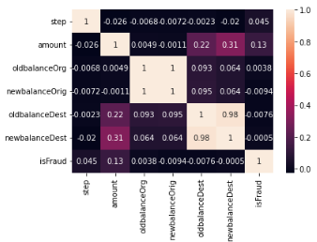
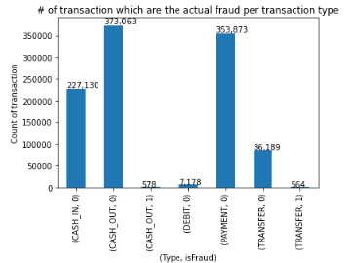
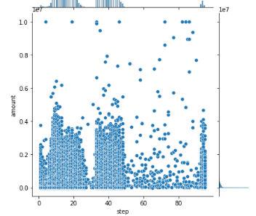
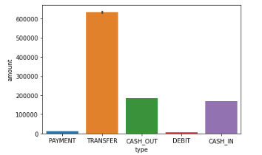
Exploratory Data Analysis

Slide 6
EXPLORATORY Data Analysis
Cash out and payment has the highest rate of transaction , cash in is lower than cash out for the bank in terms of count
Some accounts received as much as 98 credit transactions count while some account just had 1 credit transaction
In terms of amount value , transfer had the largest volume of transaction while cash out and cash in where relatively the same
Most positive fraud occurred with just two payment types, cash out and transfer
Most of the transaction used between 15 and 20 hours, while some outliers where recognized
There is a strong correlation between old balance and new balance of the destination account which is normal
No Strong correlation was seen between fraud and any feature in the data set , this might be due to the large unbalance in the data between fraud and non fraudulent transaction in the bank

Slide 7
Machine Learning Insights
Because of the unbalance ratio of fraudulent transactions to non fraudulent transactions in the bank, the data has to be balanced so that our machine learning model can work in situations where fraud is much higher and also lower
Another challenge is to make sure that out model detect as many as possible true positives and minimize false negatives in the machine learning model.
Accuracy score examines how well the trained dataset is able to predict true positives and true negatives, it is important for our model to be able to spot fraud 100 percent of the time
cross validation across the 4 models is 100% , which proves that our model is not over fitted or under fitted across the data set
The ROC AUC score helps us to compare ground truth to predicted probabilities , some the models examined gave us 100 percent when examined, personally since we have a model that have done a 100 percent across the three validation techniques , i will go for any of the four models
Based on the nature of the institution , i will suggest that the model should be more concerned with limiting false negatives that is fraud that go undetected , rather than false positives

